Slide 1


HEP Weekly Report NTUA 8/7/2020
George Bakas

Slide 2
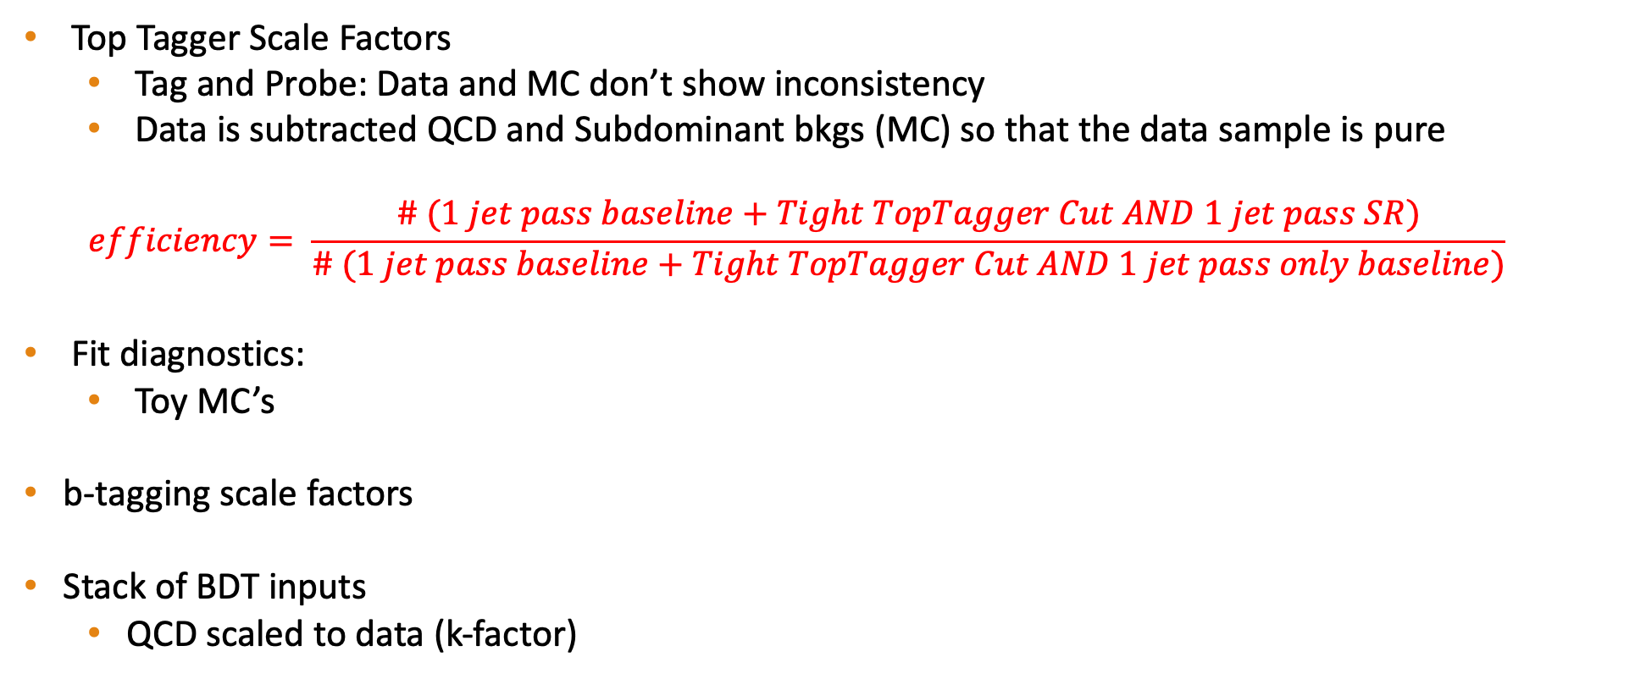
Status Report
Top Tagger Scale Factors
Tag and Probe: Data and MC don’t show inconsistency
Data is subtracted QCD and Subdominant bkgs (MC) so that the data sample is pure
$$efficiency= \frac{\# (1 jet pass baseline+Tight TopTagger Cut AND 1 jet pass SR)}{\# (1 jet pass baseline+Tight TopTagger Cut AND 1 jet pass only baseline)}$$
Fit diagnostics:
Toy MC’s
b-tagging scale factors
Stack of BDT inputs
QCD scaled to data (k-factor)

Slide 3
Signal Selection
Control Region Selection
Variables | Selected Cut
pT (both leading jets) | > 400 GeV
Njets | > 1
N leptons | = 0
|eta| (both leading jets) | < 2.4
mJJ | > 1000 GeV
jetMassSoftDrop (only for fit) | (50,300) GeV
Top Tagger | > 0.2
B tagging (2 btagged jets) | > Medium WP
Signal Trigger
Variables | Selected Cut
pT (both leading jets) | > 400 GeV
Njets | > 1
N leptons | = 0
|eta| (both leading jets) | < 2.4
mJJ | > 1000 GeV
jetMassSoftDrop (only for fit) | (50,300) GeV
Top Tagger | > 0.2
B tagging (0 btagged jets) | < Medium WP
Control Trigger

Slide 4
Stack of BDT input variables for leading and subleading jet (2016)
Leading
Sub-Leading

Slide 5
Stack of BDT input variables for leading and subleading jet (2017)
Leading
Sub-Leading

Slide 6
Stack of BDT input variables for leading and subleading jet (2018)
Leading
Sub-Leading

